Slide 1

Credit Risk Analysis Using Machine Learning Algorithms
Batch No: A03 Project Guide:
P.Nandini 164G1A0558 Mr. Lingam Suman _{M.Tech}
M.Jaya sree 164G1A0532 Assistant Professor
P.Mounika 164G1A0556
M.Bhanu Prakash 164G1A0510
Srinivasa Ramanujan Institute of Technology
Department of Computer Science & Engineering

Slide 2
Abstract
Banking industry has the major activity of lending money to those who are in need of money. When a financial institute lends money to a customer, they are taking some kind of risk. Because the customer may repay or may not repay the money.
In our project we are developing an algorithm which will generate an probability, this probability value will indicate the chances of borrowers defaulting. Defaulting means borrowers cannot repay their loan in a certain amount of time . If the borrower has high probability he can repay the money otherwise he cant repay the money.

Slide 3
Problem definition
The accurate assessment of consumer credit risk is of uttermost importance for lending organizations. Increasing the demand for consumer credit has led to the competition in credit industry. So Banking sectors have to develop and apply machine learning methods to handle analyzing credit data in order to save money and reduction of risk.

Slide 4
Existing System
In the existing system they are using the normal Classifying Algorithms to predict Credit Repaying nature of a customer.
The robustness of current traditional approaches is based on formalized hypothesis which are not capturing the fraud behavior of the Customer.
The distortions in the existing model is not easily identifiable.
This model is still far from attaining mature levels both at the methodological and at the credit granting , monitoring and control process.

Slide 5
Proposed System
In this proposed model we are building the models which will accurately predict the risk factor using the boosting algorithms using machine learning.
The main Advantages of this system is to:
Lend to right type of customers.
Monitor collections.
Predict and reduce delinquencies.
Reduce NPA and increase profitability.

Slide 6
Project planning
1. Loading the dataset
2. Exploratory data Analysis
a) Treating null and missing values
b) Treating Correlated variables
3. Feature Selection
4. Data Splitting in to train and test datasets
5. Fitting data on different algorithms
6. Cross validation
7. Hyper parameter tuning
8. Feature transformation
9. Voting Ensemble methods
10. Out of time validation

Slide 7
Data Flow Diagram
Level - 0
Input Data
Classification Algorithms
Credit Risk Analysis

Slide 8
Input data
DFD(Level – 1)
Normal data
Noisy data
Cleaning the data
Feature selection
Selecting the hyper parameter tuning
Training the model
Validation and testing
Output file

Slide 9
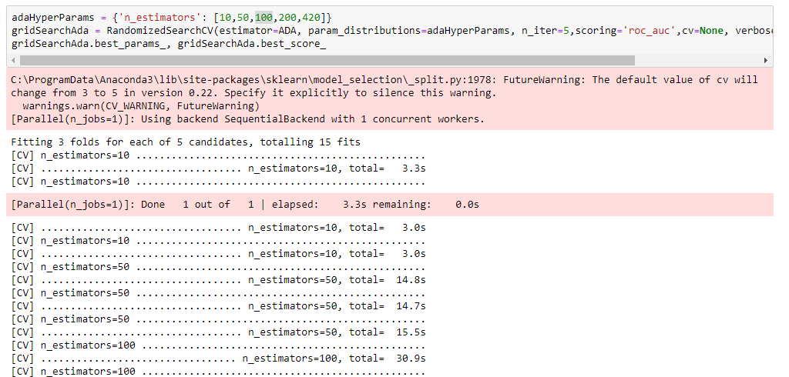
Implementation Code To Perform Hyper Parameter Tuning For Ada Boosting Algorithm

Slide 10
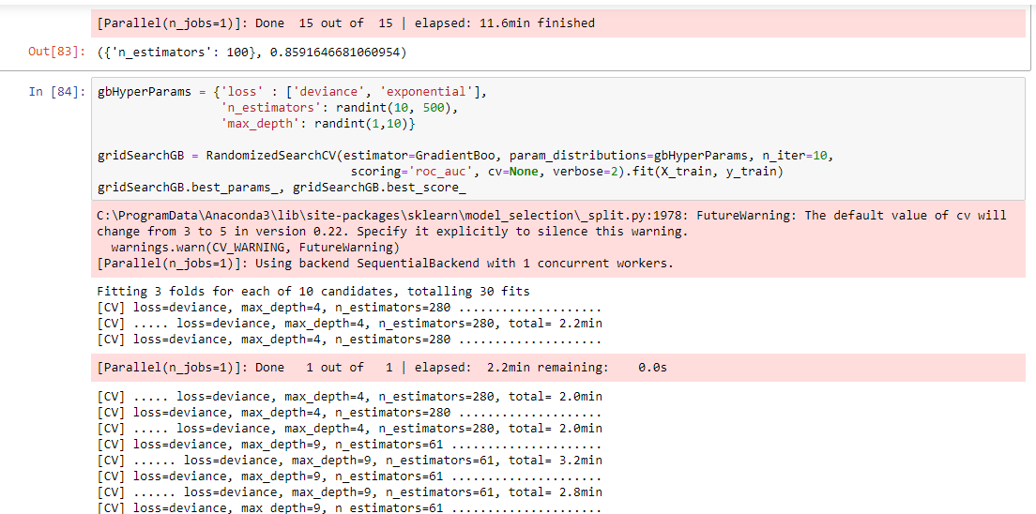
Code To Perform Hyper Parameter Tuning For Gradient Boosting Algorithm

Slide 11
Requirements
Tools used :
Jupyter notebook
Hardware Requirements :
RAM : 4 or 8 GB
Hard disk : 1 Tb
Software Required :
Jupyter Notebook
Programming Languages : Python

Slide 12
Literature Survey
Dhaiya, S., Singh, N.P., ‘Impact of Bagging on MLP classifier’, International Conferences On Computing For Sustainable Global Development, pp. 3794-3799. 2016.
Danenas,P., Grasva,G., ‘Selection Of Support Vector Machine Based Classifier For Credit Risk’, Expert System With Application , Vol. 42, pp. 3194-3204, 2015.
Credit Risk Analysis by using Machine Learning Classifier by TN Pandey - ‎International Conference on Energy, Communication, Data Analytics and Soft Computing (ICECDS-2017).

Slide 13
Thank you
Queries
?

